Slide 1
https://github.com/topics/house-price-prediction
Data mining
(or)
knowledge discovery
(or)
Predictive analysis
Example Use Case
Consider a scenario where you are a major retailer in India. You have 50 stores operating in 10 major cities in India and you have been operational for 10 years.
Let’s say, you want to study the last 8 years’ data to find the number of sales of sweets during festive seasons of 3 cities. If that’s your objective, I would recommend you employ a person with Data Mining expertise. A Data Miner would probably go through historical information stored in legacy systems and employ algorithms to extract trends.
Consider another case where you want to know which sweets have received more positive reviews. In this case, your sources of data may not be limited to databases, they could extend to social websites or customer feedback messages. In this case, my suggestion to you would be to employ a Data Scientist. A person employed as a Data Scientist is more suited to apply algorithms and conduct this socio-computational analysis.

Slide 2
Data mining steps :
1. Exploration – In this step, the data is cleared and converted into another form. The nature of data is also determined
2. Pattern Identification – The next step is to choose the pattern which will make the best prediction
3. Deployment – The identified patterns are used to get the desired outcome.
Data mining steps :
1. Data Collection : This is one of the most important steps in Data mining as getting the correct data is always a challenge in any organization. To find patterns in the data, we
need to ensure that the source of the data is accurate and as much as possible data is gathered.
2. Data Cleaning : A lot of the times the data we get is not clean enough to draw insights from it. There could be missing values, outliers, NULL in the data which needs to be
handled either by deletion or by imputation based on its significance to the business.
3. Data Analysis : Once the data is gathered, and cleaned the next step is to analyze the data which in short known as Exploratory Data Analysis. Several techniques and
methodologies are applied in this step to derive relevant insights from the data.
4. Data Interpretation : Only analyzing the data is worthless unless it is interpreted through the form of graphs or charts to the stakeholders or the business who would make
conclusions based on the analysis.

Slide 3
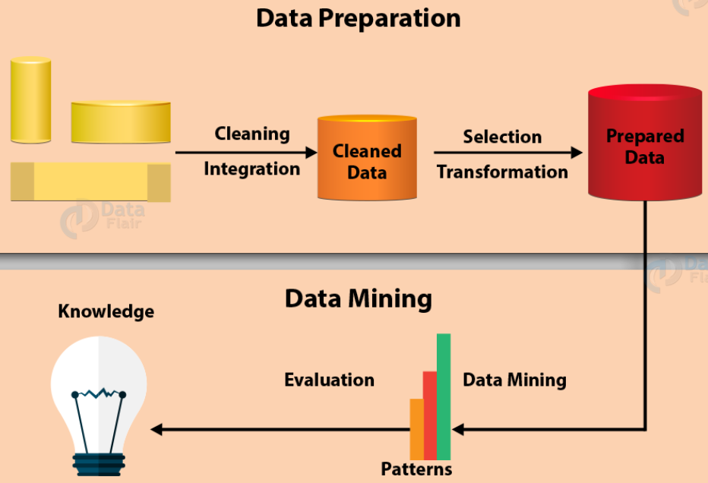
Stages of Data Mining Process
Data Mining Process is classified into two stages:
1. Data preparation or data preprocessing
a. Data cleaning
b. Data integration
c. Data selection
d. Data transformation
2. Data mining
a. pattern evaluation
b. knowledge representation

Slide 4
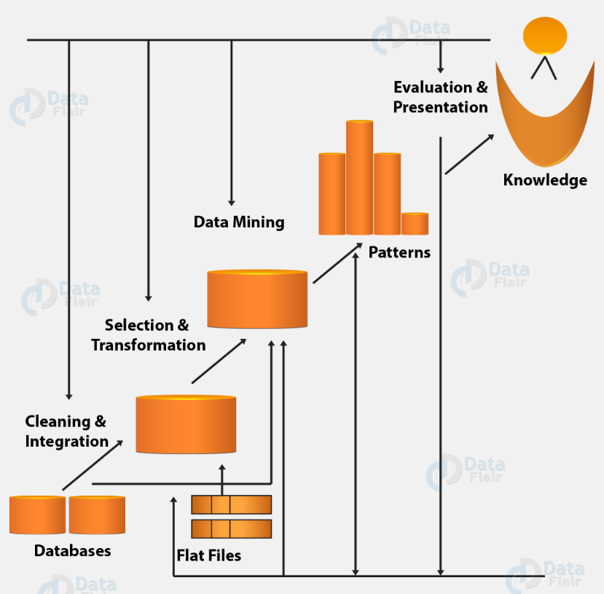

Slide 5
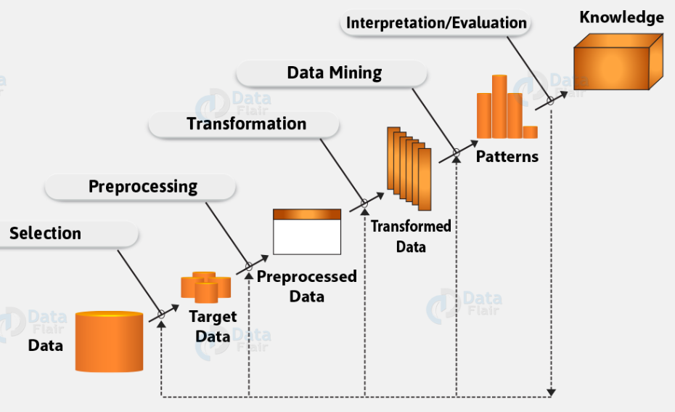
Five Major Elements of Data Mining

Slide 6

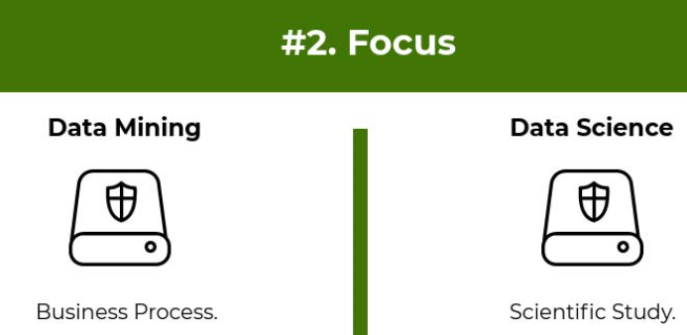
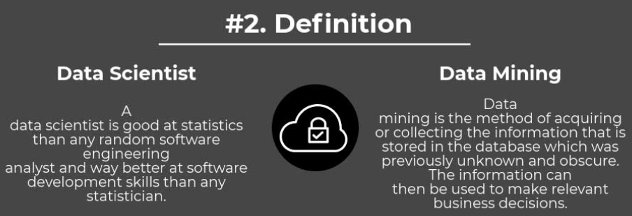
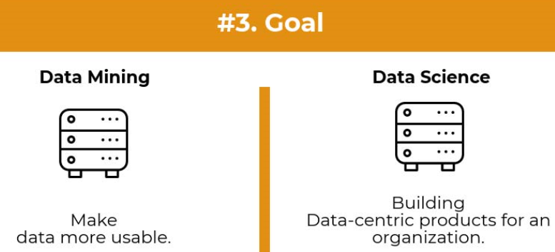
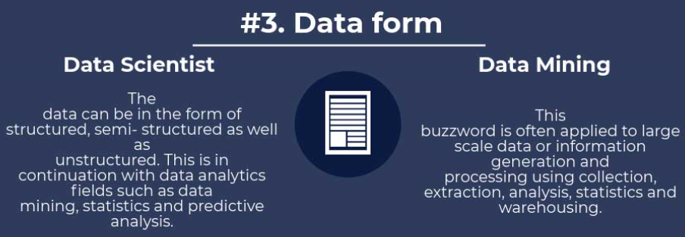
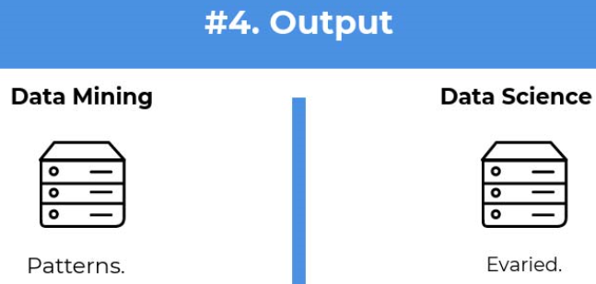

Slide 7
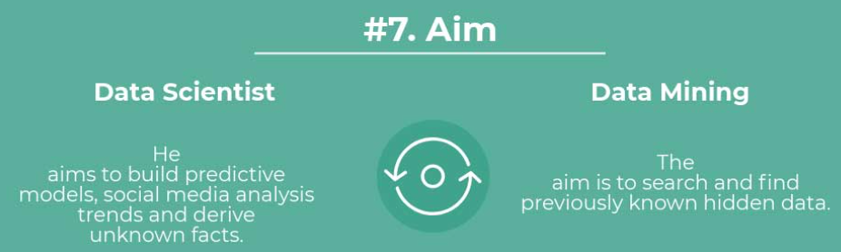
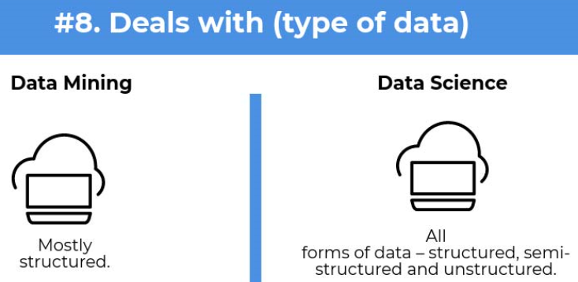
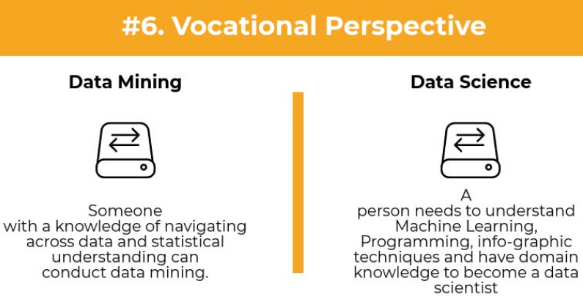
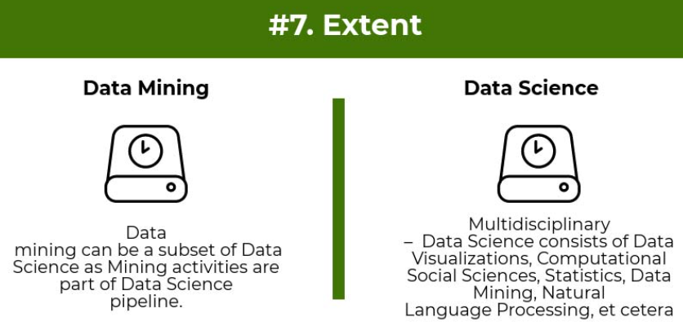
Finding trends previous not known

Slide 8
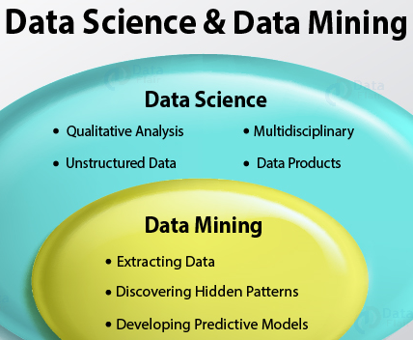
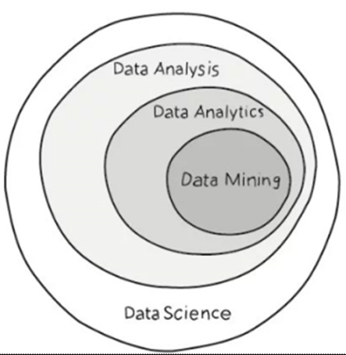
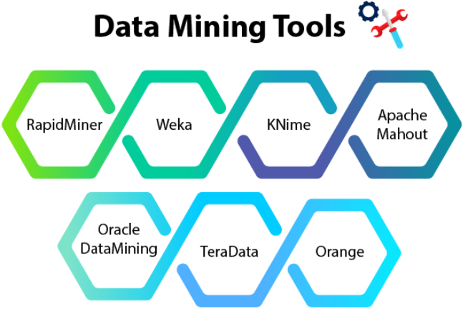
Data Mining Tools

Slide 9
https://www.youtube.com/watch?v=BB2O4VCu5j8
Data Mining

Slide 10
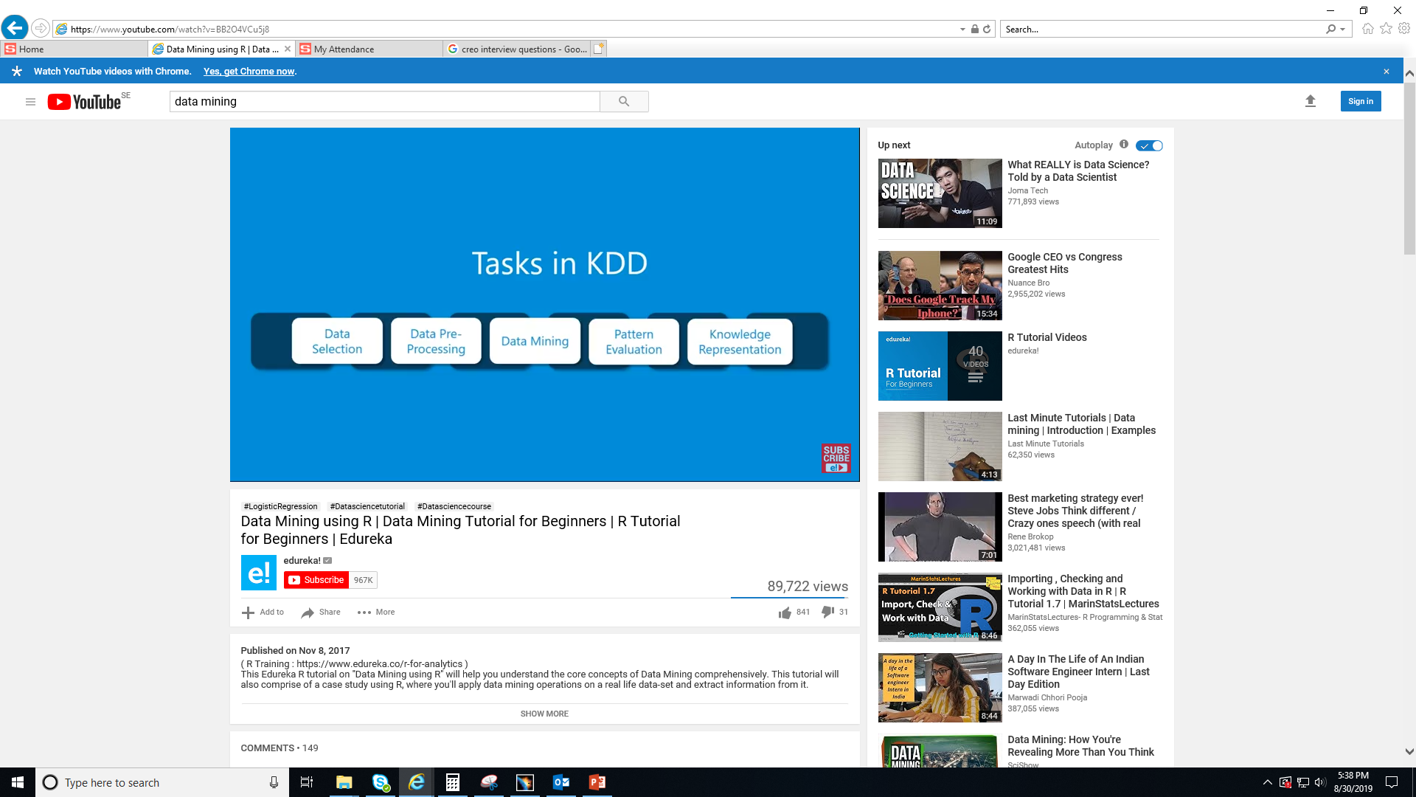
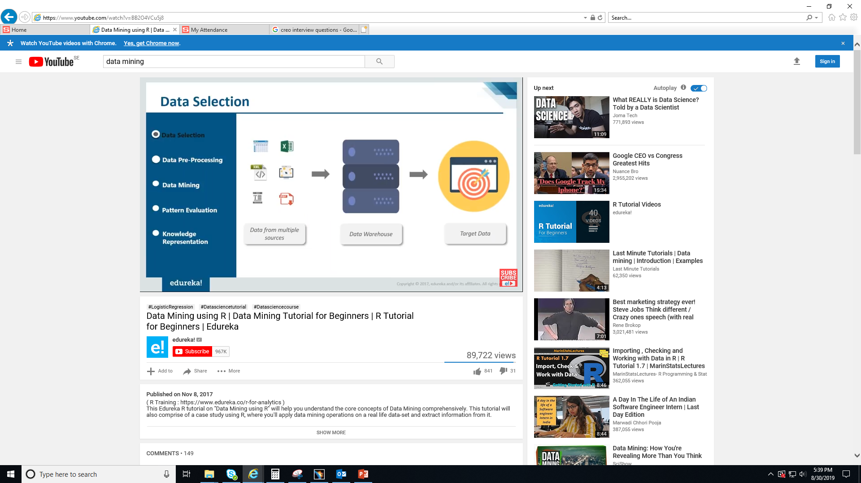

Slide 11
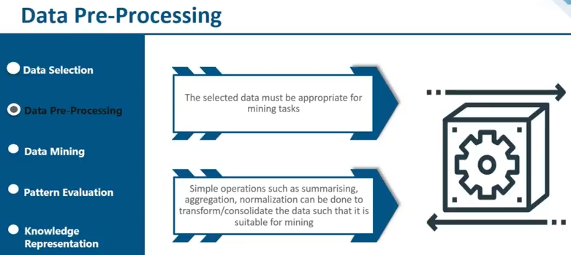
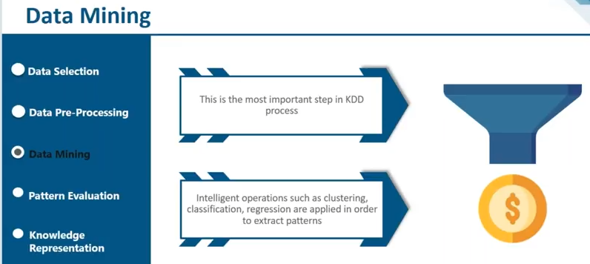

Slide 12
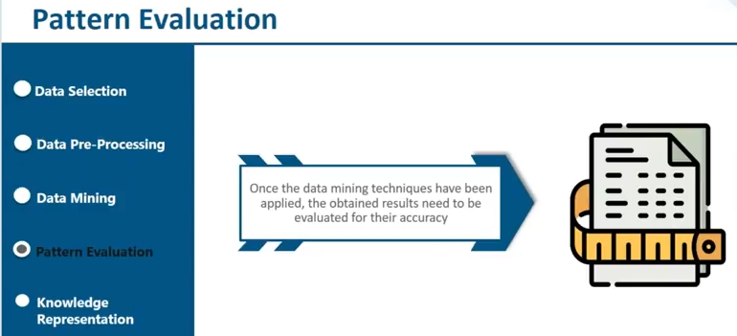
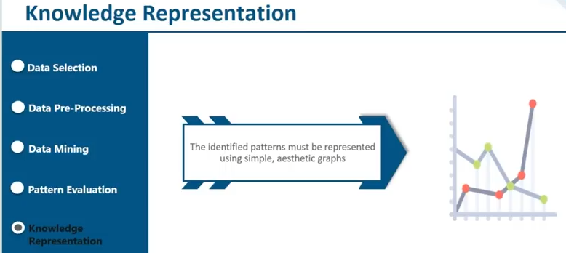

Slide 13
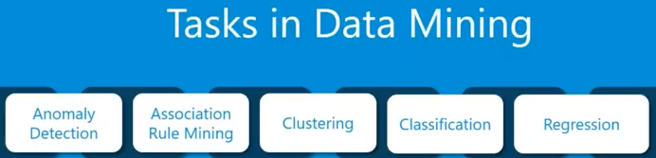

Slide 14
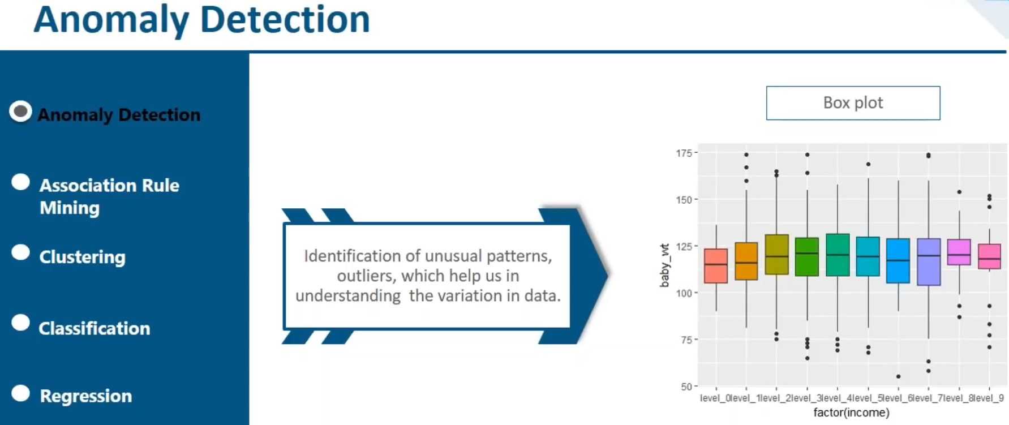

Slide 15
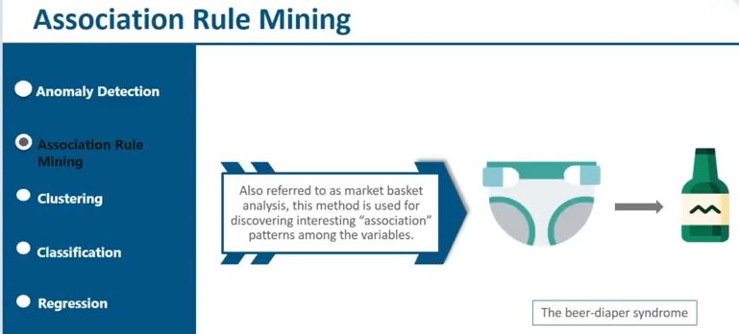
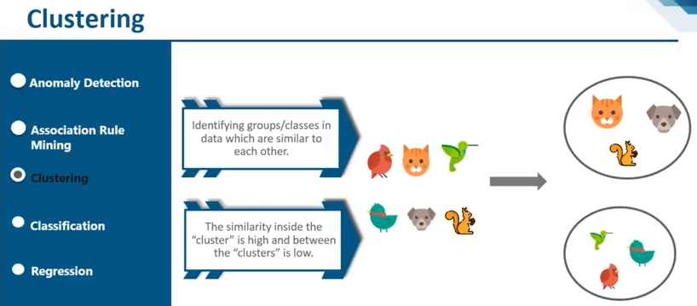
Market Basket Analysis

Slide 16
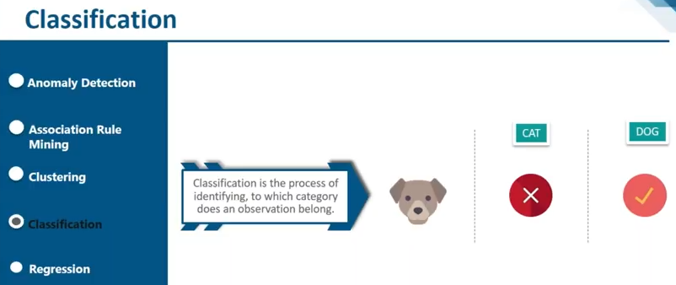
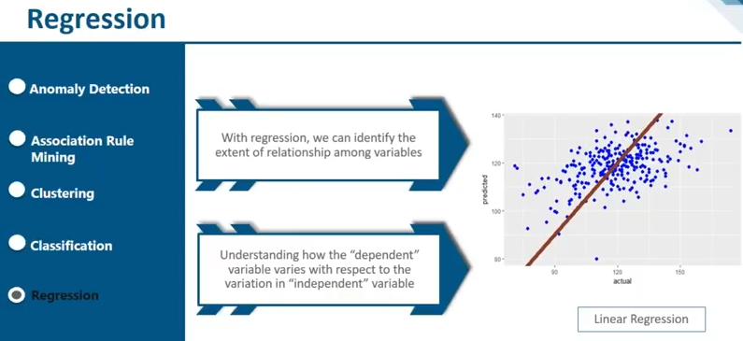

Slide 17
